Slide 1
An Exploration of Crash Severity
Aaron, Alex, and Sam
Notes:
Des Moines Area Metropolitan Planning Organization

Slide 2
Topics
Hypotheses
Distracted Driving
Important Factors
Tableau Visualizations

Slide 3
Initial Hypotheses
Factors beside human error, such as street layout, design, etc., contribute to a crash’s severity
Geographic correlation with crash severity
Further Exploration
Fatalities could be explained through the crash data
Traffic would contribute to CSeverity
Notes:
Specific cases/roads that illustrate main takeaways

Slide 4
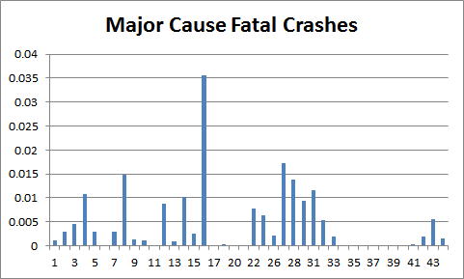
Distracted Driving
16: Failed to keep in proper lane
8: Operating vehicle in a reckless, erratic, careless, negligent manner
31: Passing where prohibited
Notes:
16 -
27 -
8 -
28 -
31 -

Slide 5
Controllable Significant Factors
CSURFCONDITION, ROADTYPE, MEDTYPE, MEDWIDTH, NUMLANES
Determined through statistical testing
CSURFCONDITION, ROADTYPE, MEDTYPE
Poisson Stepwise Regression
Notes:
Bar chart that shows severity metric for each significant factor

Slide 6
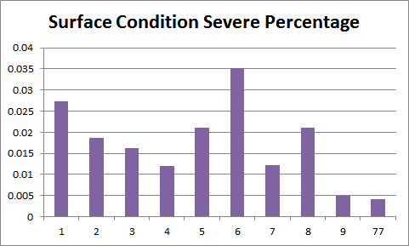
CSURFCOND
6: Mud/Dirt
4: Snow
1: Dry
Notes:
1- dry. 2- wet. 3- ice/frost 4- snow 5-slush 6- mud/dirt 8- sand.
Muddy conditions led to 16 crashes.

Slide 7
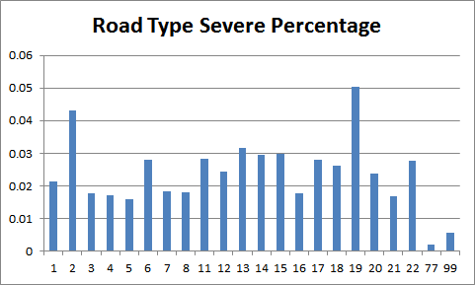
ROADTYPE
19: Unknown
2: Bike Lanes
13: T-Intersection
15: Five points or more
14: Y-Intersection

Slide 8
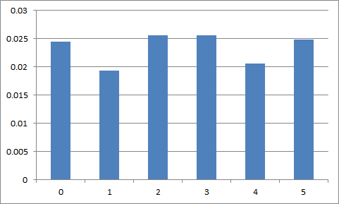
MEDTYPE
1: Hard surface without barrier
4: Grass surface with barrier

Slide 9
Tableau Demonstration

Slide 10
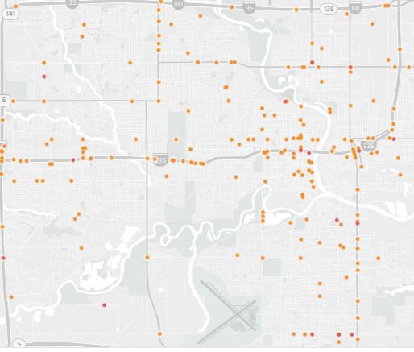
CSurfCond
Notes:
Wet and Muddy Conditions Particularly dangerous on I-235 more so than other highways. Also SE 14th street.

Slide 11
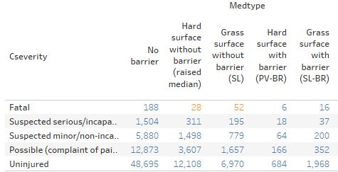
MedType
More fatal deaths with Grass Surface without barrier than hard surface without barrier
Hard Surface without barrier fatality rate: .0016
Grass surface without barrier (SL) fatality rate: .0054
Notes:
How do i keep getting different numbers than alex’s graph.

Slide 12


Grass vs. Hard Surface
I-65: Grass surface without barrier has nine deaths along single stretch.
I-6: Hard surface without barrier (raised median) only has two.
Hard surface/raised median safer than grass surface median for interstates
I-65
Transposed I-6

Slide 13
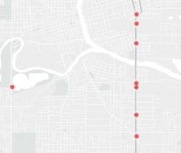
Further Exploration:
Although we suspect hard surface without barrier
is safer, 9 deaths happened on SE 14th street, so
further qualitative analysis is needed.

Slide 14
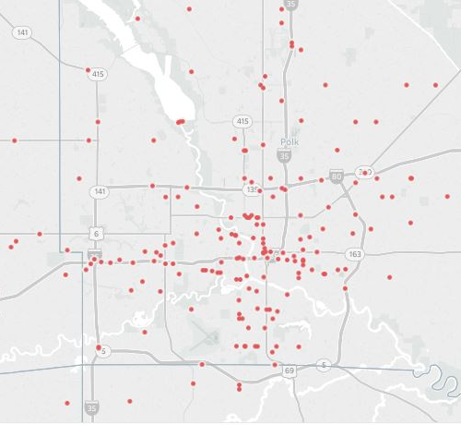
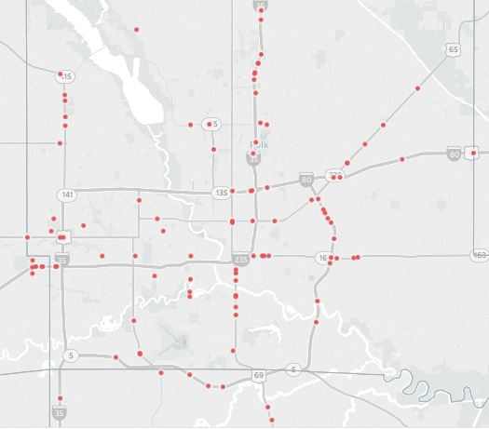
No Medians Medians
Notes:
Both images exclude highways.
You can see more crashes occur without some sort of median present.

Slide 15
In Conclusion: Findings
CSurfcond
Mud/Dirt
Medtype
Without Barrier: Hard Surface
For interstates
With Barrier: Grass Surface
Streets with medians have less deaths than those without medians
Roadtype
Worst is unknown
Bike lanes
T-, Y-, and five point intersection dangers
Distracted Driving

Slide 16
Questions?
aaron.m.feldman@drake.edu
samuel.hehir@drake.edu
hongbo.zhang@drake.edu

